Slide 1
54 2e 48 2e 41 2e 4e 2e 4f 2e 53 2e

Slide 2

54 2e 48 2e 41 2e 4e 2e 4f 2e 53 2e

Slide 3

source: https://www.teiss.co.uk/news/darkside-extracts-44m-ransom-from-german-chemical-distribution-company-8920
54 2e 48 2e 41 2e 4e 2e 4f 2e 53 2e
Notes:
https://d1wqtxts1xzle7.cloudfront.net/54805069/2e695acd7636367c106d6c347544ed131b98-libre.pdf?1508848530=&response-content-disposition=inline%3B+filename%3DComparison_of_network_security_tools_Fir.pdf&Expires=1682541432&Signature=cWAYG6kvmo~JhMI7lYh7T6NnvvAW5mBzism2jm0VGbA8-H1zREXHo4QGyHF8EWvNwyLTo9d3XEyx7AaV3Wft7ITHEu1M1BDJRfJmpil6eyYbNkfIiplOjWJ-BPLZWg4ZRNqH3fbi4iv-m76dgL2bqDAu7-NBuFBsHt75fmJ6RGiNFPqtoAAgD2TGI7j60PyzZzebgWYIiLctMHwKpybrvxTC-QaO4~eDU4XOAxDTZzL4ovKw4hW9MDAAHVD46PvzlA9WP6TBtAt4mKpRzFtTLcB~uzICxRIGcReOoemYKJywU5uiGb3D4EqtO80T1eRF6-0pv2unl0cts~x2rL76iA__&Key-Pair-Id=APKAJLOHF5GGSLRBV4ZA Scenario: A distributed denial-of-service (DDoS) attack is targeting a company's web server
In this example, multiple systems controlled by an attacker are sending a massive amount of traffic to the company's web server, overwhelming its resources and making it unavailable to legitimate users. This attack aims to exhaust the server's bandwidth, processing capacity, or memory, rendering it unable to serve legitimate requests.
Firewall's limitations in this scenario:
A firewall is primarily designed to filter traffic based on predefined rules, such as allowing or blocking specific IP addresses, ports, or protocols. In a DDoS attack, the malicious traffic may use the same ports and protocols as legitimate traffic, making it difficult for a firewall to differentiate between them and filter out the attack traffic.
Since DDoS attacks often involve a large number of attacking systems (also known as a botnet), blocking individual IP addresses is generally not an effective countermeasure. The attacker can easily replace blocked IPs with new ones, continuing the attack.
Firewalls typically lack advanced traffic analysis capabilities required to detect and mitigate more sophisticated DDoS attacks, such as application-layer attacks, which target specific services or applications on the server.
In many cases, the sheer volume of traffic generated during a DDoS attack can overwhelm the firewall itself, rendering it unable to function properly and protect the network.
In summary, while firewalls are an essential component of network security, they are not designed to react to or initiate effective countermeasures against certain types of attacks, like DDoS attacks. To protect against such threats, organizations need to implement additional security measures, such as intrusion detection/prevention systems (IDS/IPS), traffic analysis tools, and advanced DDoS mitigation solutions.
Scenario: A company uses a firewall to protect its internal network from external threats.
In this example, the firewall is configured to allow or block traffic based on predefined rules that examine the packet headers, such as the source and destination IP addresses, ports, and protocols. The firewall does not inspect the actual contents of the packets, such as the payload data.
Now, suppose an attacker tries to infiltrate the company's network by exploiting a vulnerability in a web server hosted internally. The attacker crafts a malicious HTTP request that contains a payload designed to exploit the web server's vulnerability.
When the request passes through the firewall, the firewall examines the packet header and allows the traffic because it appears to be legitimate HTTP traffic. The firewall does not analyze the payload data or recognize the malicious code within it.
As a result, the malicious payload reaches the web server, and the attacker gains unauthorized access to the system. The attacker can then use this access to further exploit the network or steal sensitive data.
In this scenario, the firewall's inability to analyze the payload data and recognize the malicious code allowed the attacker to bypass the firewall's protection and infiltrate the network. This highlights the limitations of traditional firewall technology in today's threat landscape, where attackers use sophisticated techniques to evade detection and exploit vulnerabilities.
To enhance the security of the network, companies may need to deploy additional security measures that can analyze the contents of the data packets, such as intrusion prevention systems (IPS) or next-generation firewalls (NGFW). These solutions can inspect the payload data and detect and block malicious traffic, providing a higher level of protection against sophisticated attacks.

Slide 4
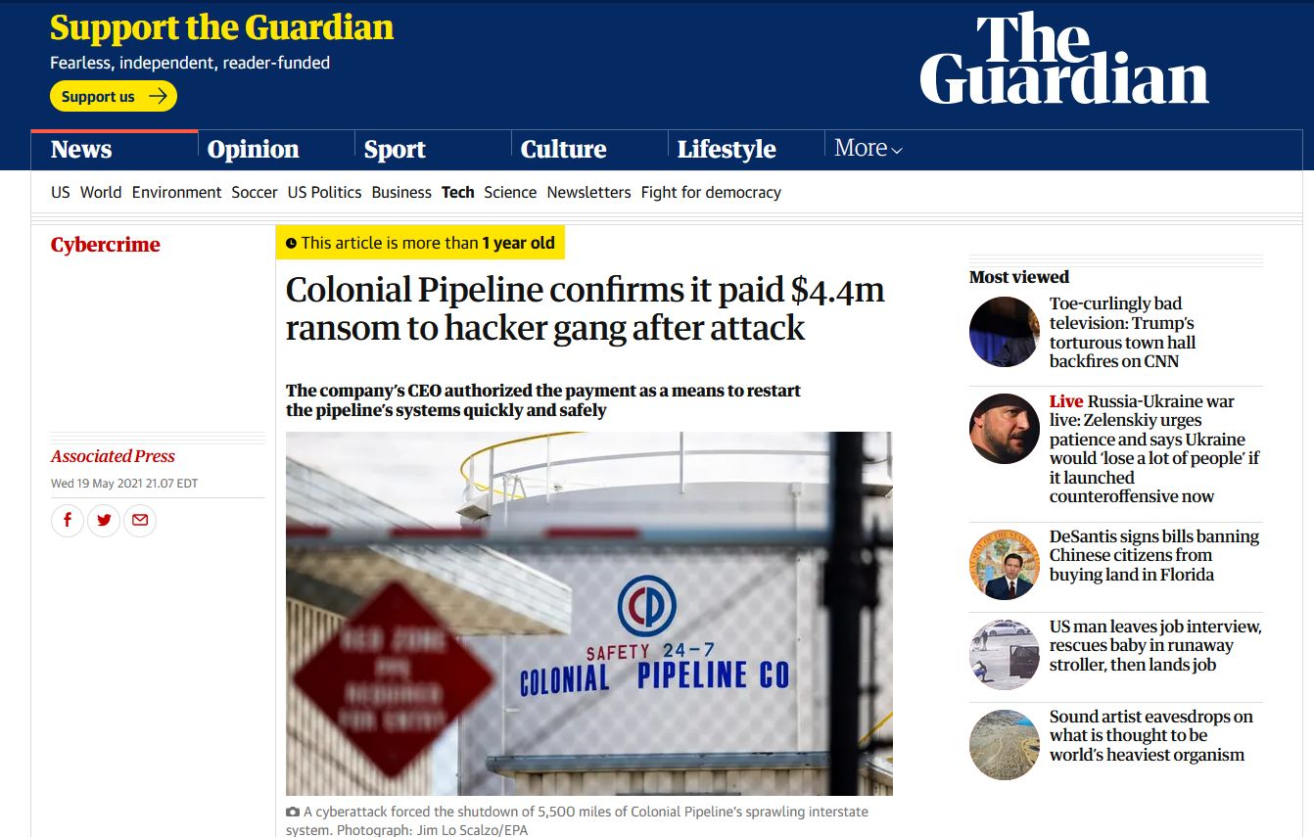
source: https://www.teiss.co.uk/news/darkside-extracts-44m-ransom-from-german-chemical-distribution-company-8920
54 2e 48 2e 41 2e 4e 2e 4f 2e 53 2e
Notes:
https://d1wqtxts1xzle7.cloudfront.net/54805069/2e695acd7636367c106d6c347544ed131b98-libre.pdf?1508848530=&response-content-disposition=inline%3B+filename%3DComparison_of_network_security_tools_Fir.pdf&Expires=1682541432&Signature=cWAYG6kvmo~JhMI7lYh7T6NnvvAW5mBzism2jm0VGbA8-H1zREXHo4QGyHF8EWvNwyLTo9d3XEyx7AaV3Wft7ITHEu1M1BDJRfJmpil6eyYbNkfIiplOjWJ-BPLZWg4ZRNqH3fbi4iv-m76dgL2bqDAu7-NBuFBsHt75fmJ6RGiNFPqtoAAgD2TGI7j60PyzZzebgWYIiLctMHwKpybrvxTC-QaO4~eDU4XOAxDTZzL4ovKw4hW9MDAAHVD46PvzlA9WP6TBtAt4mKpRzFtTLcB~uzICxRIGcReOoemYKJywU5uiGb3D4EqtO80T1eRF6-0pv2unl0cts~x2rL76iA__&Key-Pair-Id=APKAJLOHF5GGSLRBV4ZA Scenario: A distributed denial-of-service (DDoS) attack is targeting a company's web server
In this example, multiple systems controlled by an attacker are sending a massive amount of traffic to the company's web server, overwhelming its resources and making it unavailable to legitimate users. This attack aims to exhaust the server's bandwidth, processing capacity, or memory, rendering it unable to serve legitimate requests.
Firewall's limitations in this scenario:
A firewall is primarily designed to filter traffic based on predefined rules, such as allowing or blocking specific IP addresses, ports, or protocols. In a DDoS attack, the malicious traffic may use the same ports and protocols as legitimate traffic, making it difficult for a firewall to differentiate between them and filter out the attack traffic.
Since DDoS attacks often involve a large number of attacking systems (also known as a botnet), blocking individual IP addresses is generally not an effective countermeasure. The attacker can easily replace blocked IPs with new ones, continuing the attack.
Firewalls typically lack advanced traffic analysis capabilities required to detect and mitigate more sophisticated DDoS attacks, such as application-layer attacks, which target specific services or applications on the server.
In many cases, the sheer volume of traffic generated during a DDoS attack can overwhelm the firewall itself, rendering it unable to function properly and protect the network.
In summary, while firewalls are an essential component of network security, they are not designed to react to or initiate effective countermeasures against certain types of attacks, like DDoS attacks. To protect against such threats, organizations need to implement additional security measures, such as intrusion detection/prevention systems (IDS/IPS), traffic analysis tools, and advanced DDoS mitigation solutions.
Scenario: A company uses a firewall to protect its internal network from external threats.
In this example, the firewall is configured to allow or block traffic based on predefined rules that examine the packet headers, such as the source and destination IP addresses, ports, and protocols. The firewall does not inspect the actual contents of the packets, such as the payload data.
Now, suppose an attacker tries to infiltrate the company's network by exploiting a vulnerability in a web server hosted internally. The attacker crafts a malicious HTTP request that contains a payload designed to exploit the web server's vulnerability.
When the request passes through the firewall, the firewall examines the packet header and allows the traffic because it appears to be legitimate HTTP traffic. The firewall does not analyze the payload data or recognize the malicious code within it.
As a result, the malicious payload reaches the web server, and the attacker gains unauthorized access to the system. The attacker can then use this access to further exploit the network or steal sensitive data.
In this scenario, the firewall's inability to analyze the payload data and recognize the malicious code allowed the attacker to bypass the firewall's protection and infiltrate the network. This highlights the limitations of traditional firewall technology in today's threat landscape, where attackers use sophisticated techniques to evade detection and exploit vulnerabilities.
To enhance the security of the network, companies may need to deploy additional security measures that can analyze the contents of the data packets, such as intrusion prevention systems (IPS) or next-generation firewalls (NGFW). These solutions can inspect the payload data and detect and block malicious traffic, providing a higher level of protection against sophisticated attacks.

Slide 5
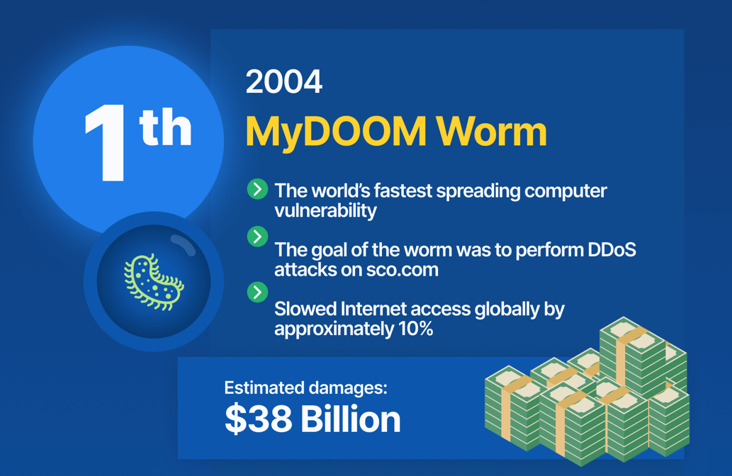
source: https://www.webfx.com/blog/internet/cost-of-computer-viruses-infographic/
54 2e 48 2e 41 2e 4e 2e 4f 2e 53 2e
Notes:
https://d1wqtxts1xzle7.cloudfront.net/54805069/2e695acd7636367c106d6c347544ed131b98-libre.pdf?1508848530=&response-content-disposition=inline%3B+filename%3DComparison_of_network_security_tools_Fir.pdf&Expires=1682541432&Signature=cWAYG6kvmo~JhMI7lYh7T6NnvvAW5mBzism2jm0VGbA8-H1zREXHo4QGyHF8EWvNwyLTo9d3XEyx7AaV3Wft7ITHEu1M1BDJRfJmpil6eyYbNkfIiplOjWJ-BPLZWg4ZRNqH3fbi4iv-m76dgL2bqDAu7-NBuFBsHt75fmJ6RGiNFPqtoAAgD2TGI7j60PyzZzebgWYIiLctMHwKpybrvxTC-QaO4~eDU4XOAxDTZzL4ovKw4hW9MDAAHVD46PvzlA9WP6TBtAt4mKpRzFtTLcB~uzICxRIGcReOoemYKJywU5uiGb3D4EqtO80T1eRF6-0pv2unl0cts~x2rL76iA__&Key-Pair-Id=APKAJLOHF5GGSLRBV4ZA Scenario: A distributed denial-of-service (DDoS) attack is targeting a company's web server
In this example, multiple systems controlled by an attacker are sending a massive amount of traffic to the company's web server, overwhelming its resources and making it unavailable to legitimate users. This attack aims to exhaust the server's bandwidth, processing capacity, or memory, rendering it unable to serve legitimate requests.
Firewall's limitations in this scenario:
A firewall is primarily designed to filter traffic based on predefined rules, such as allowing or blocking specific IP addresses, ports, or protocols. In a DDoS attack, the malicious traffic may use the same ports and protocols as legitimate traffic, making it difficult for a firewall to differentiate between them and filter out the attack traffic.
Since DDoS attacks often involve a large number of attacking systems (also known as a botnet), blocking individual IP addresses is generally not an effective countermeasure. The attacker can easily replace blocked IPs with new ones, continuing the attack.
Firewalls typically lack advanced traffic analysis capabilities required to detect and mitigate more sophisticated DDoS attacks, such as application-layer attacks, which target specific services or applications on the server.
In many cases, the sheer volume of traffic generated during a DDoS attack can overwhelm the firewall itself, rendering it unable to function properly and protect the network.
In summary, while firewalls are an essential component of network security, they are not designed to react to or initiate effective countermeasures against certain types of attacks, like DDoS attacks. To protect against such threats, organizations need to implement additional security measures, such as intrusion detection/prevention systems (IDS/IPS), traffic analysis tools, and advanced DDoS mitigation solutions.
Scenario: A company uses a firewall to protect its internal network from external threats.
In this example, the firewall is configured to allow or block traffic based on predefined rules that examine the packet headers, such as the source and destination IP addresses, ports, and protocols. The firewall does not inspect the actual contents of the packets, such as the payload data.
Now, suppose an attacker tries to infiltrate the company's network by exploiting a vulnerability in a web server hosted internally. The attacker crafts a malicious HTTP request that contains a payload designed to exploit the web server's vulnerability.
When the request passes through the firewall, the firewall examines the packet header and allows the traffic because it appears to be legitimate HTTP traffic. The firewall does not analyze the payload data or recognize the malicious code within it.
As a result, the malicious payload reaches the web server, and the attacker gains unauthorized access to the system. The attacker can then use this access to further exploit the network or steal sensitive data.
In this scenario, the firewall's inability to analyze the payload data and recognize the malicious code allowed the attacker to bypass the firewall's protection and infiltrate the network. This highlights the limitations of traditional firewall technology in today's threat landscape, where attackers use sophisticated techniques to evade detection and exploit vulnerabilities.
To enhance the security of the network, companies may need to deploy additional security measures that can analyze the contents of the data packets, such as intrusion prevention systems (IPS) or next-generation firewalls (NGFW). These solutions can inspect the payload data and detect and block malicious traffic, providing a higher level of protection against sophisticated attacks.

Slide 6
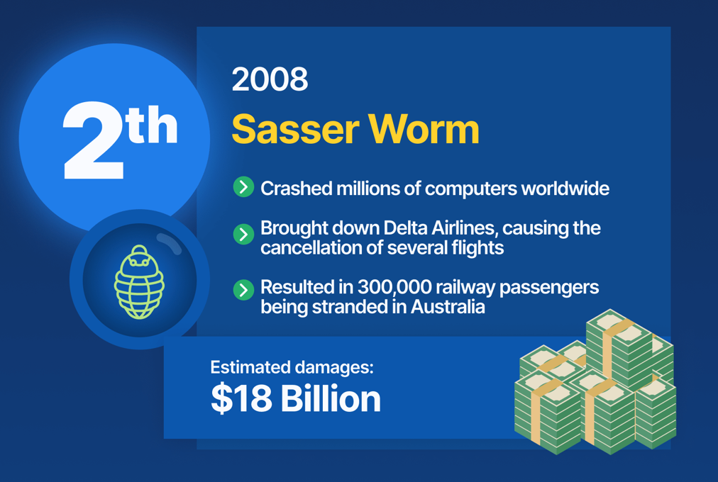
source: https://www.webfx.com/blog/internet/cost-of-computer-viruses-infographic/
54 2e 48 2e 41 2e 4e 2e 4f 2e 53 2e
Notes:
https://d1wqtxts1xzle7.cloudfront.net/54805069/2e695acd7636367c106d6c347544ed131b98-libre.pdf?1508848530=&response-content-disposition=inline%3B+filename%3DComparison_of_network_security_tools_Fir.pdf&Expires=1682541432&Signature=cWAYG6kvmo~JhMI7lYh7T6NnvvAW5mBzism2jm0VGbA8-H1zREXHo4QGyHF8EWvNwyLTo9d3XEyx7AaV3Wft7ITHEu1M1BDJRfJmpil6eyYbNkfIiplOjWJ-BPLZWg4ZRNqH3fbi4iv-m76dgL2bqDAu7-NBuFBsHt75fmJ6RGiNFPqtoAAgD2TGI7j60PyzZzebgWYIiLctMHwKpybrvxTC-QaO4~eDU4XOAxDTZzL4ovKw4hW9MDAAHVD46PvzlA9WP6TBtAt4mKpRzFtTLcB~uzICxRIGcReOoemYKJywU5uiGb3D4EqtO80T1eRF6-0pv2unl0cts~x2rL76iA__&Key-Pair-Id=APKAJLOHF5GGSLRBV4ZA Scenario: A distributed denial-of-service (DDoS) attack is targeting a company's web server
In this example, multiple systems controlled by an attacker are sending a massive amount of traffic to the company's web server, overwhelming its resources and making it unavailable to legitimate users. This attack aims to exhaust the server's bandwidth, processing capacity, or memory, rendering it unable to serve legitimate requests.
Firewall's limitations in this scenario:
A firewall is primarily designed to filter traffic based on predefined rules, such as allowing or blocking specific IP addresses, ports, or protocols. In a DDoS attack, the malicious traffic may use the same ports and protocols as legitimate traffic, making it difficult for a firewall to differentiate between them and filter out the attack traffic.
Since DDoS attacks often involve a large number of attacking systems (also known as a botnet), blocking individual IP addresses is generally not an effective countermeasure. The attacker can easily replace blocked IPs with new ones, continuing the attack.
Firewalls typically lack advanced traffic analysis capabilities required to detect and mitigate more sophisticated DDoS attacks, such as application-layer attacks, which target specific services or applications on the server.
In many cases, the sheer volume of traffic generated during a DDoS attack can overwhelm the firewall itself, rendering it unable to function properly and protect the network.
In summary, while firewalls are an essential component of network security, they are not designed to react to or initiate effective countermeasures against certain types of attacks, like DDoS attacks. To protect against such threats, organizations need to implement additional security measures, such as intrusion detection/prevention systems (IDS/IPS), traffic analysis tools, and advanced DDoS mitigation solutions.
Scenario: A company uses a firewall to protect its internal network from external threats.
In this example, the firewall is configured to allow or block traffic based on predefined rules that examine the packet headers, such as the source and destination IP addresses, ports, and protocols. The firewall does not inspect the actual contents of the packets, such as the payload data.
Now, suppose an attacker tries to infiltrate the company's network by exploiting a vulnerability in a web server hosted internally. The attacker crafts a malicious HTTP request that contains a payload designed to exploit the web server's vulnerability.
When the request passes through the firewall, the firewall examines the packet header and allows the traffic because it appears to be legitimate HTTP traffic. The firewall does not analyze the payload data or recognize the malicious code within it.
As a result, the malicious payload reaches the web server, and the attacker gains unauthorized access to the system. The attacker can then use this access to further exploit the network or steal sensitive data.
In this scenario, the firewall's inability to analyze the payload data and recognize the malicious code allowed the attacker to bypass the firewall's protection and infiltrate the network. This highlights the limitations of traditional firewall technology in today's threat landscape, where attackers use sophisticated techniques to evade detection and exploit vulnerabilities.
To enhance the security of the network, companies may need to deploy additional security measures that can analyze the contents of the data packets, such as intrusion prevention systems (IPS) or next-generation firewalls (NGFW). These solutions can inspect the payload data and detect and block malicious traffic, providing a higher level of protection against sophisticated attacks.

Slide 7



things are way serious than you think!
3
HOMES
4
7%
31%
IN
270
attacks per
CORPORATION
of AMERICAN ADULTS
have had their personal information exposed by cyber criminals
with computers are infected with
MALICIOUS SOFTWARE
over an year (in 2021), an increase of 31% from 2020
*Cybersecurity & Infrastructure Security Agency, Official America’s Cyber Defense Agency https://www.cisa.gov/be-cyber-smart/facts
*https://www.accenture.com/
54 2e 48 2e 41 2e 4e 2e 4f 2e 53 2e
Notes:
https://d1wqtxts1xzle7.cloudfront.net/54805069/2e695acd7636367c106d6c347544ed131b98-libre.pdf?1508848530=&response-content-disposition=inline%3B+filename%3DComparison_of_network_security_tools_Fir.pdf&Expires=1682541432&Signature=cWAYG6kvmo~JhMI7lYh7T6NnvvAW5mBzism2jm0VGbA8-H1zREXHo4QGyHF8EWvNwyLTo9d3XEyx7AaV3Wft7ITHEu1M1BDJRfJmpil6eyYbNkfIiplOjWJ-BPLZWg4ZRNqH3fbi4iv-m76dgL2bqDAu7-NBuFBsHt75fmJ6RGiNFPqtoAAgD2TGI7j60PyzZzebgWYIiLctMHwKpybrvxTC-QaO4~eDU4XOAxDTZzL4ovKw4hW9MDAAHVD46PvzlA9WP6TBtAt4mKpRzFtTLcB~uzICxRIGcReOoemYKJywU5uiGb3D4EqtO80T1eRF6-0pv2unl0cts~x2rL76iA__&Key-Pair-Id=APKAJLOHF5GGSLRBV4ZA Scenario: A distributed denial-of-service (DDoS) attack is targeting a company's web server
In this example, multiple systems controlled by an attacker are sending a massive amount of traffic to the company's web server, overwhelming its resources and making it unavailable to legitimate users. This attack aims to exhaust the server's bandwidth, processing capacity, or memory, rendering it unable to serve legitimate requests.
Firewall's limitations in this scenario:
A firewall is primarily designed to filter traffic based on predefined rules, such as allowing or blocking specific IP addresses, ports, or protocols. In a DDoS attack, the malicious traffic may use the same ports and protocols as legitimate traffic, making it difficult for a firewall to differentiate between them and filter out the attack traffic.
Since DDoS attacks often involve a large number of attacking systems (also known as a botnet), blocking individual IP addresses is generally not an effective countermeasure. The attacker can easily replace blocked IPs with new ones, continuing the attack.
Firewalls typically lack advanced traffic analysis capabilities required to detect and mitigate more sophisticated DDoS attacks, such as application-layer attacks, which target specific services or applications on the server.
In many cases, the sheer volume of traffic generated during a DDoS attack can overwhelm the firewall itself, rendering it unable to function properly and protect the network.
In summary, while firewalls are an essential component of network security, they are not designed to react to or initiate effective countermeasures against certain types of attacks, like DDoS attacks. To protect against such threats, organizations need to implement additional security measures, such as intrusion detection/prevention systems (IDS/IPS), traffic analysis tools, and advanced DDoS mitigation solutions.
Scenario: A company uses a firewall to protect its internal network from external threats.
In this example, the firewall is configured to allow or block traffic based on predefined rules that examine the packet headers, such as the source and destination IP addresses, ports, and protocols. The firewall does not inspect the actual contents of the packets, such as the payload data.
Now, suppose an attacker tries to infiltrate the company's network by exploiting a vulnerability in a web server hosted internally. The attacker crafts a malicious HTTP request that contains a payload designed to exploit the web server's vulnerability.
When the request passes through the firewall, the firewall examines the packet header and allows the traffic because it appears to be legitimate HTTP traffic. The firewall does not analyze the payload data or recognize the malicious code within it.
As a result, the malicious payload reaches the web server, and the attacker gains unauthorized access to the system. The attacker can then use this access to further exploit the network or steal sensitive data.
In this scenario, the firewall's inability to analyze the payload data and recognize the malicious code allowed the attacker to bypass the firewall's protection and infiltrate the network. This highlights the limitations of traditional firewall technology in today's threat landscape, where attackers use sophisticated techniques to evade detection and exploit vulnerabilities.
To enhance the security of the network, companies may need to deploy additional security measures that can analyze the contents of the data packets, such as intrusion prevention systems (IPS) or next-generation firewalls (NGFW). These solutions can inspect the payload data and detect and block malicious traffic, providing a higher level of protection against sophisticated attacks.

Slide 8








firewalls: deceptive veil of trust
0 1 0 1 1 0 1 1 1 0
home repair men allowed entry on face value
packet contents not inspected, accepted on face value
54 2e 48 2e 41 2e 4e 2e 4f 2e 53 2e
Notes:
https://d1wqtxts1xzle7.cloudfront.net/54805069/2e695acd7636367c106d6c347544ed131b98-libre.pdf?1508848530=&response-content-disposition=inline%3B+filename%3DComparison_of_network_security_tools_Fir.pdf&Expires=1682541432&Signature=cWAYG6kvmo~JhMI7lYh7T6NnvvAW5mBzism2jm0VGbA8-H1zREXHo4QGyHF8EWvNwyLTo9d3XEyx7AaV3Wft7ITHEu1M1BDJRfJmpil6eyYbNkfIiplOjWJ-BPLZWg4ZRNqH3fbi4iv-m76dgL2bqDAu7-NBuFBsHt75fmJ6RGiNFPqtoAAgD2TGI7j60PyzZzebgWYIiLctMHwKpybrvxTC-QaO4~eDU4XOAxDTZzL4ovKw4hW9MDAAHVD46PvzlA9WP6TBtAt4mKpRzFtTLcB~uzICxRIGcReOoemYKJywU5uiGb3D4EqtO80T1eRF6-0pv2unl0cts~x2rL76iA__&Key-Pair-Id=APKAJLOHF5GGSLRBV4ZA Scenario: A distributed denial-of-service (DDoS) attack is targeting a company's web server
In this example, multiple systems controlled by an attacker are sending a massive amount of traffic to the company's web server, overwhelming its resources and making it unavailable to legitimate users. This attack aims to exhaust the server's bandwidth, processing capacity, or memory, rendering it unable to serve legitimate requests.
Firewall's limitations in this scenario:
A firewall is primarily designed to filter traffic based on predefined rules, such as allowing or blocking specific IP addresses, ports, or protocols. In a DDoS attack, the malicious traffic may use the same ports and protocols as legitimate traffic, making it difficult for a firewall to differentiate between them and filter out the attack traffic.
Since DDoS attacks often involve a large number of attacking systems (also known as a botnet), blocking individual IP addresses is generally not an effective countermeasure. The attacker can easily replace blocked IPs with new ones, continuing the attack.
Firewalls typically lack advanced traffic analysis capabilities required to detect and mitigate more sophisticated DDoS attacks, such as application-layer attacks, which target specific services or applications on the server.
In many cases, the sheer volume of traffic generated during a DDoS attack can overwhelm the firewall itself, rendering it unable to function properly and protect the network.
In summary, while firewalls are an essential component of network security, they are not designed to react to or initiate effective countermeasures against certain types of attacks, like DDoS attacks. To protect against such threats, organizations need to implement additional security measures, such as intrusion detection/prevention systems (IDS/IPS), traffic analysis tools, and advanced DDoS mitigation solutions.
Scenario: A company uses a firewall to protect its internal network from external threats.
In this example, the firewall is configured to allow or block traffic based on predefined rules that examine the packet headers, such as the source and destination IP addresses, ports, and protocols. The firewall does not inspect the actual contents of the packets, such as the payload data.
Now, suppose an attacker tries to infiltrate the company's network by exploiting a vulnerability in a web server hosted internally. The attacker crafts a malicious HTTP request that contains a payload designed to exploit the web server's vulnerability.
When the request passes through the firewall, the firewall examines the packet header and allows the traffic because it appears to be legitimate HTTP traffic. The firewall does not analyze the payload data or recognize the malicious code within it.
As a result, the malicious payload reaches the web server, and the attacker gains unauthorized access to the system. The attacker can then use this access to further exploit the network or steal sensitive data.
In this scenario, the firewall's inability to analyze the payload data and recognize the malicious code allowed the attacker to bypass the firewall's protection and infiltrate the network. This highlights the limitations of traditional firewall technology in today's threat landscape, where attackers use sophisticated techniques to evade detection and exploit vulnerabilities.
To enhance the security of the network, companies may need to deploy additional security measures that can analyze the contents of the data packets, such as intrusion prevention systems (IPS) or next-generation firewalls (NGFW). These solutions can inspect the payload data and detect and block malicious traffic, providing a higher level of protection against sophisticated attacks.

Slide 9


firewalls: deceptive veil of trust
Distributed Denial of Service (DDoS) attacks
gang of robbers
54 2e 48 2e 41 2e 4e 2e 4f 2e 53 2e
Notes:
https://d1wqtxts1xzle7.cloudfront.net/54805069/2e695acd7636367c106d6c347544ed131b98-libre.pdf?1508848530=&response-content-disposition=inline%3B+filename%3DComparison_of_network_security_tools_Fir.pdf&Expires=1682541432&Signature=cWAYG6kvmo~JhMI7lYh7T6NnvvAW5mBzism2jm0VGbA8-H1zREXHo4QGyHF8EWvNwyLTo9d3XEyx7AaV3Wft7ITHEu1M1BDJRfJmpil6eyYbNkfIiplOjWJ-BPLZWg4ZRNqH3fbi4iv-m76dgL2bqDAu7-NBuFBsHt75fmJ6RGiNFPqtoAAgD2TGI7j60PyzZzebgWYIiLctMHwKpybrvxTC-QaO4~eDU4XOAxDTZzL4ovKw4hW9MDAAHVD46PvzlA9WP6TBtAt4mKpRzFtTLcB~uzICxRIGcReOoemYKJywU5uiGb3D4EqtO80T1eRF6-0pv2unl0cts~x2rL76iA__&Key-Pair-Id=APKAJLOHF5GGSLRBV4ZA Scenario: A distributed denial-of-service (DDoS) attack is targeting a company's web server
In this example, multiple systems controlled by an attacker are sending a massive amount of traffic to the company's web server, overwhelming its resources and making it unavailable to legitimate users. This attack aims to exhaust the server's bandwidth, processing capacity, or memory, rendering it unable to serve legitimate requests.
Firewall's limitations in this scenario:
A firewall is primarily designed to filter traffic based on predefined rules, such as allowing or blocking specific IP addresses, ports, or protocols. In a DDoS attack, the malicious traffic may use the same ports and protocols as legitimate traffic, making it difficult for a firewall to differentiate between them and filter out the attack traffic.
Since DDoS attacks often involve a large number of attacking systems (also known as a botnet), blocking individual IP addresses is generally not an effective countermeasure. The attacker can easily replace blocked IPs with new ones, continuing the attack.
Firewalls typically lack advanced traffic analysis capabilities required to detect and mitigate more sophisticated DDoS attacks, such as application-layer attacks, which target specific services or applications on the server.
In many cases, the sheer volume of traffic generated during a DDoS attack can overwhelm the firewall itself, rendering it unable to function properly and protect the network.
In summary, while firewalls are an essential component of network security, they are not designed to react to or initiate effective countermeasures against certain types of attacks, like DDoS attacks. To protect against such threats, organizations need to implement additional security measures, such as intrusion detection/prevention systems (IDS/IPS), traffic analysis tools, and advanced DDoS mitigation solutions.
Scenario: A company uses a firewall to protect its internal network from external threats.
In this example, the firewall is configured to allow or block traffic based on predefined rules that examine the packet headers, such as the source and destination IP addresses, ports, and protocols. The firewall does not inspect the actual contents of the packets, such as the payload data.
Now, suppose an attacker tries to infiltrate the company's network by exploiting a vulnerability in a web server hosted internally. The attacker crafts a malicious HTTP request that contains a payload designed to exploit the web server's vulnerability.
When the request passes through the firewall, the firewall examines the packet header and allows the traffic because it appears to be legitimate HTTP traffic. The firewall does not analyze the payload data or recognize the malicious code within it.
As a result, the malicious payload reaches the web server, and the attacker gains unauthorized access to the system. The attacker can then use this access to further exploit the network or steal sensitive data.
In this scenario, the firewall's inability to analyze the payload data and recognize the malicious code allowed the attacker to bypass the firewall's protection and infiltrate the network. This highlights the limitations of traditional firewall technology in today's threat landscape, where attackers use sophisticated techniques to evade detection and exploit vulnerabilities.
To enhance the security of the network, companies may need to deploy additional security measures that can analyze the contents of the data packets, such as intrusion prevention systems (IPS) or next-generation firewalls (NGFW). These solutions can inspect the payload data and detect and block malicious traffic, providing a higher level of protection against sophisticated attacks.

Slide 10


shallow packet inspection
exposed against DDoS attacks
anomaly detection limited to layer-4
54 2e 48 2e 41 2e 4e 2e 4f 2e 53 2e
Notes:
https://docs.netgate.com/pfsense/en/latest/hardware/size.html

Slide 11




FIREPOWER
Solutions exists
54 2e 48 2e 41 2e 4e 2e 4f 2e 53 2e
Notes:
https://docs.netgate.com/pfsense/en/latest/hardware/size.html

Slide 12





0 1 0 1 1 0 1
deep packet inspection
distributed denial of Service (DDoS) attacks
shallow packet inspection
detecting insider threats*
anomaly detection
exposed against DDoS attacks
anomaly detection limited to layer-4
custom rules
*By analyzing the contents of the application layer, we can expose sensitive data access, and thereby policy violations might be identified, something firewalls can’t achieve.
54 2e 48 2e 41 2e 4e 2e 4f 2e 53 2e
Notes:
https://docs.netgate.com/pfsense/en/latest/hardware/size.html

Slide 13



0 1 0 1 1 0 1
deep packet inspection
distributed denial of Service (DDoS) attacks
shoo away a group of people
detecting insider threats*
anomaly detection
bag inspection before letting in
custom rules
54 2e 48 2e 41 2e 4e 2e 4f 2e 53 2e
Notes:
https://docs.netgate.com/pfsense/en/latest/hardware/size.html

Slide 14





inadequate protection against high-bandwidth (DDoS) attacks
100
gbps
Solutions exists
but..
expensive for higher
bandwidth requirements
54 2e 48 2e 41 2e 4e 2e 4f 2e 53 2e
H . S N . T . A . O .
Notes:
https://docs.netgate.com/pfsense/en/latest/hardware/size.html

Slide 15
A 2.e H .2e 41 N .4e T. S 2e O 2e.
54 2e 48 2e 41 2e 4e 2e 4f 2e 53 2e

Slide 16

T.H.A.N.O.S
True Hardware Accelerated NIDS Offloading System
Notes:
T.H.A.N.O.S. True Hardware Accelerated NIDS Offloading System
Protection against all kinds of attacks – powered by deep packet inspection
reduced user frustration – powered by low false positives
lower operation costs – low false positives means no need for manpower to be deployed to go through all the positives and segregate real positives from fake positives
low setup costs – fpga costs much less for same bandwidth as real systems

Slide 17
Deep Packet Inspection
IP
TCP
HTTP
Application Data
Traditional Packet Analysis
Protection against all Signature-based attacks
T.H.A.N.O.S

Slide 18

T.H.A.N.O.S
lower capital cost for same throughput
Deep Packet Inspection
IP
TCP
HTTP
Application Data
Traditional Packet Analysis
Notes:
Protection against all kinds of attacks – powered by deep packet inspection
reduced user frustration – powered by low false positives
lower operation costs – low false positives means no need for manpower to be deployed to go through all the positives and segregate real positives from fake positives
low setup costs – fpga costs much less for same bandwidth as real systems

Slide 19



T.H.A.N.O.S
lower operational cost for zero false positives
Deep Packet Inspection
IP
TCP
HTTP
Application Data
Traditional Packet Analysis

Slide 20

T.H.A.N.O.S
Deep Packet Inspection
IP
TCP
HTTP
Application Data
Traditional Packet Analysis

Slide 21
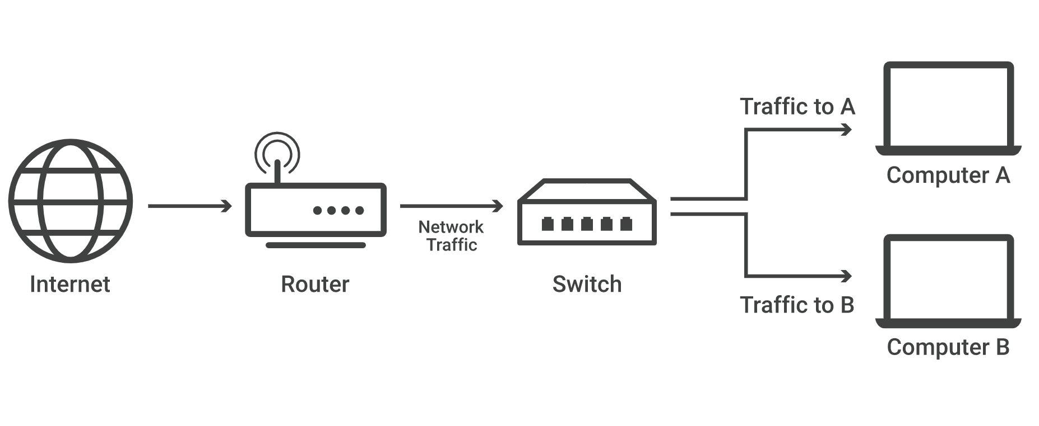


T.H.A.N.O.S
Traffic to A
Computer A
Router/IDS
(T.H.A.N.O.S)
Internet
Traffic to B
Computer B
Notes:
Showing how a package is flow through from the internet
First having a message coming in and go through
Then again

Slide 22
T.H.A.N.O.S
IDS Accelerator
Dual Core Multithread
64 bits CPU
Traffic to A
Computer A
Core 1
Core 2
Router/IDS
(T.H.A.N.O.S)
Internet
Traffic to B
Computer B
Notes:
When the package go into our T.H.A.N.O.S zooming into the architecture
Saying package coming into our router/ids which consist of two cores and a hardware accelerator

Slide 23
T.H.A.N.O.S
IDS Accelerator
Core 1
Core 2
Notes:
Quick view on the flow inside thanos

Slide 24
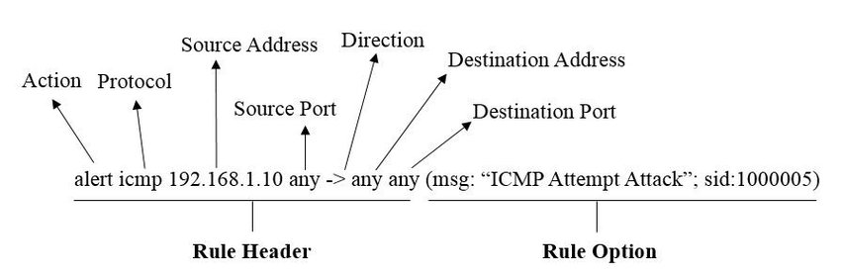
T.H.A.N.O.S
Core 1
Flow
Protocol
IP Addresses
Port Number
Header Fields
HELEN
URI
(HTTP only)
Version
Notes:
So what will CPU do?
Header field extraction
As snort rules covers multiple different combinations of header fields, we will need to extract these fields to know what rules apply to this package

Slide 25
T.H.A.N.O.S
IDS Accelerator
Core 1
Core 2
Notes:
Quick view on the flow inside thanos

Slide 26
T.H.A.N.O.S
IDS Accelerator
Extracted Fields from CPU
Load Payload from CPU Memory
…
CAMs
CAMs
…
CAMs
CAMs
CAMs
…
Index Generator
Bloom Filter
Notes:
Using the header that cpu provided
To do Header index extraction
EtherType, SourceIP, SrcPort, DestinationIP, DstPort, Protocol, Version, HELEN, flow, established, nocase, http_uri, service content

Slide 27
T.H.A.N.O.S
IDS Accelerator
Extracted Fields from CPU
Protocol, SourceIP, SrcPort, DestinationIP, DstPort, Version, HELEN, http_uri, flow
…
CAMs
CAMs
CAMs
CAMs
CAMs
CAMs
…
…
Index Generator
Notes:
Using the header that cpu provided
To do Header index extraction
EtherType, SourceIP, SrcPort, DestinationIP, DstPort, Protocol, Version, HELEN, flow, established, nocase, http_uri, service content

Slide 28
T.H.A.N.O.S
IDS Accelerator
Extracted Fields from CPU
Protocol, SourceIP, SrcPort, DestinationIP, DstPort, Version, HELEN, http_uri, flow
…
CAMs
CAMs
CAMs
CAMs
CAMs
CAMs
…
…
Index Generator
Version
SrcPort
DstPort
HELEN
http_uri
SourceIP
DstIP
Protocol
Flow
0001 1111 0010 001010000 001 1 1 010 0111
Notes:
Using the header that cpu provided
To do Header index extraction
EtherType, SourceIP, SrcPort, DestinationIP, DstPort, Protocol, Version, HELEN, flow, established, nocase, http_uri, service content

Slide 29
T.H.A.N.O.S
IDS Accelerator
Deep packet inspection(DPI) with Bloom Filter
Index
N Bytes from Payload
0001 1111 0010 001010000 001 1 1 010 0111
Notes:
Quick view on the flow inside thanos

Slide 30
T.H.A.N.O.S
IDS Accelerator
Deep packet inspection(DPI) with Bloom Filter
Index
N Bytes from Payload
0001 1111 0010 001010000 001 1 1 010 0111
[ E2/a.ph … 9 ]
N characters
E
2
/
a
.
p
h
8…
9
9
2
u
m
S
7
Notes:
Quick view on the flow inside thanos

Slide 31
T.H.A.N.O.S
IDS Accelerator
Deep packet inspection(DPI) with Bloom Filter
Index
N Bytes from Payload
0001 1111 0010 001010000 001 1 1 010 0111
[ 2/a.ph … 99 ]
E
2
/
a
.
p
h
8…
9
9
2
u
m
S
7
Notes:
Quick view on the flow inside thanos

Slide 32
T.H.A.N.O.S
IDS Accelerator
Deep packet inspection(DPI) with Bloom Filter
Index
N Bytes from Payload
0001 1111 0010 001010000 001 1 1 010 0111
[ h … 992umS7 ]
E
2
/
a
.
p
h
8…
9
9
2
u
m
S
7
Notes:
Quick view on the flow inside thanos

Slide 33
T.H.A.N.O.S
IDS Accelerator
Deep packet inspection(DPI) with Bloom Filter
Hash Func.
[ ]
Hash Func.
[ ]
Index
N Bytes from Payload
…
…
Hash Func.
[ ]
Hash Func.
[ ]
Hash Table
0
0
0
1
0
1
0
8…
0
1
0
1
1
1
1
Notes:
Quick view on the flow inside thanos

Slide 34
T.H.A.N.O.S
IDS Accelerator
Deep packet inspection(DPI) with Bloom Filter
Hash Func.
Index
pidfile
Hash Func.
N Bytes from Payloadc
Hash Func.
Hash Table
1
1
1
0
1
0
0
0
0
1
0
0
1
1
Notes:
Quick view on the flow inside thanos

Slide 35
T.H.A.N.O.S
IDS Accelerator
Deep packet inspection(DPI) with Bloom Filter
Hash Func.
[ 0 ]
Index
pidfile
Hash Func.
[ 9 ]
N Bytes from Payload
Hash Func.
[ 2 ]
real snort rule content
Hash Table
1
1
1
0
1
0
0
0
0
1
0
0
1
1
Notes:
Quick view on the flow inside thanos

Slide 36
T.H.A.N.O.S
IDS Accelerator
Deep packet inspection(DPI) with Bloom Filter
Hash Func.
[ 0 ]
Index
pidfile
Hash Func.
[ 9 ]
N Bytes from Payload
Hash Func.
[ 2 ]
Hash Table
1
1
1
0
1
0
0
0
0
1
0
0
1
1
Notes:
Quick view on the flow inside thanos

Slide 37
T.H.A.N.O.S
IDS Accelerator
Core 1
Core 2
Notes:
Quick view on the flow inside thanos

Slide 38

T.H.A.N.O.S
Secondary Verification
Software verification to prevent false positive
Forward extracted header fields for efficient matching
Notes:
Still need to decide on the order (this first or pipeline first )

Slide 39
T.H.A.N.O.S
Traffic to A
Computer A
Router/IDS
(T.H.A.N.O.S)
Internet
Traffic to B
Computer B
Secondary Verification
Notes:
Malicious pattern

Slide 40
T.H.A.N.O.S
Header Field Extraction(CPU)
Index Generation + DPI (IDS)
Packet redirection if needed
C1
Index
DPI
C1

Slide 41
T.H.A.N.O.S
C1
Index
DPI
C1
C2
Waiting for IDS
Index
DPI
C2
C1
wait…
Index
DPI
…
C2
wait…
…

Slide 42
T.H.A.N.O.S
header
detection options
content
distance/offset
options
actions
protocol
IP addresses
port number
direction operator
general options
message
flow
reference
classtype
sid/rev
within/depth
pcre
byte test
rules
alert
log
pass
drop
scalable to 11500+ rules
8
rules implemented
rules with single content field
TCP
HTTP
7 bytes
length of pattern matcher
Protocols
UDP
* atleast 8500 out of 11500 snort rules require to be checked when http connection is established, that is packets that are transacted after first three packets (after SYN, SYN-ACK, ACK)

Slide 43
Bandwidth Analysis
avg Snort s/w Bandwidth (Mbits/s) | avg Snort s/w Bandwidth (Mbits/s)
169.1666667 | 2020.693333

Slide 44
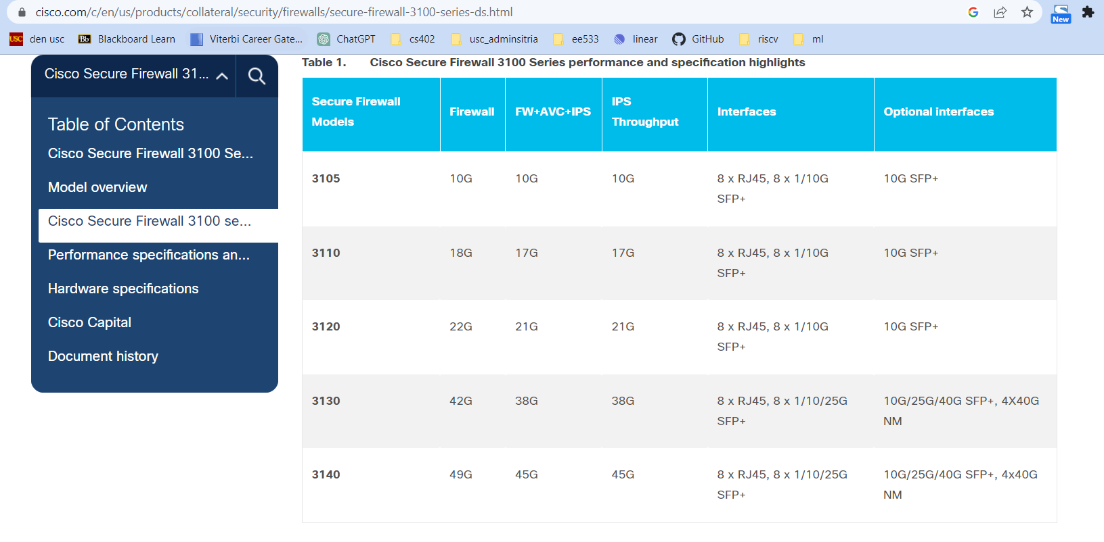
T.H.A.N.O.S
Cisco Firepower 3120 claimed IPS bandwidth is 21Gbps

Slide 45

T.H.A.N.O.S

Slide 46
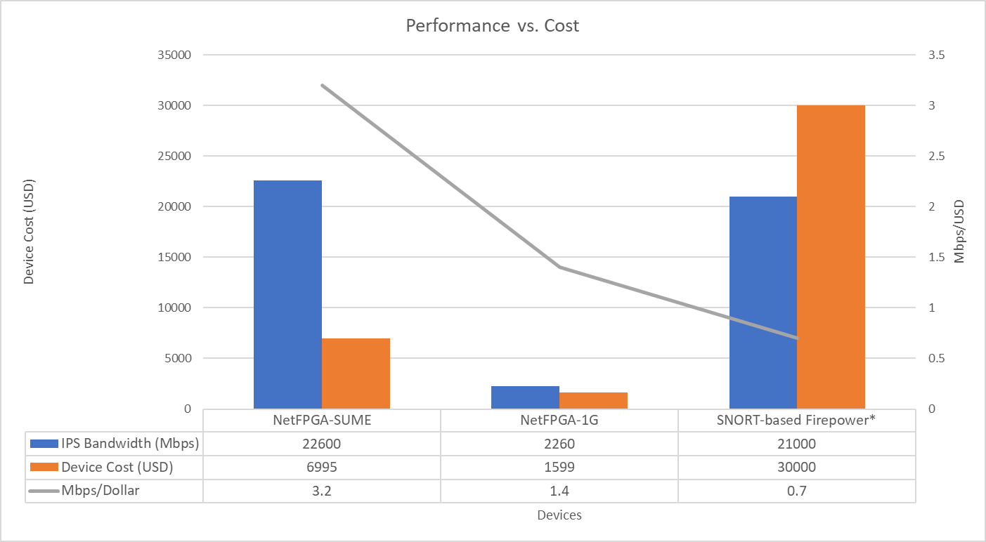
T.H.A.N.O.S
5.5x
nearly same bandwidth,
8x cheaper
cost advantage

Slide 47
opportunity
IDC Tracker, Q2 2022
Vendor | 4Q22 Revenue | 4Q22 Market Share | 4Q21 Revenue | 4Q21 Market Share | 4Q22/4Q21 Growth
1. Palo Alto Networks | $973.75 | 15.90% | $883.35 | 15.10% | 10.20%
3. Fortinet | $966.61 | 15.80% | $776.23 | 13.30% | 24.50%
2. Cisco | $921.08 | 15.80% | $885.79 | 15.20% | 4.00%
4. Check Point | $473.04 | 7.70% | $462.55 | 7.90% | 2.30%
5. SonicWALL | $194.16 | 3.20% | $183.50 | 3.10% | 5.80%
Rest of Market | $2,582.05 | 42.30% | $2,645.27 | 45.30% | -2.40%
Total | $6,110.69
x 4 = 24, 400
Bn. USD Yearly Revenue
T.H.A.N.O.S

Slide 48
opportunity
Total Market Size* (Mn. USD) | 24400
Cisco After Tax Profit Margin | 20%
Cisco Revenue* (Mn. USD) | 3772
Cisco profit margin* (Mn. USD) | 754.4
* yearly for security appliance business
20%
profit margin
Source: https://www.forbes.com/sites/johndorfman/2022/09/06/cisco-biogen-four-fat-margin-buys/?sh=22430ee23a00
T.H.A.N.O.S

Slide 49
opportunity
Field | Values
Total Market Size* (Mn. USD) | 24400
Target Market Share | 20%
Time frame (Years) | 3
Number of Quarters | 12
Market Share per Quarter | 1.67%
Avg. ASP per device (USD) | 4,000
Number of Devices yearly | 6,100,000
Profit Margin | 20.00%
Cost Price | 6,995
Gross Profit Margin | 1,399
Selling Price | 8,394
Nearest Competitor | Cisco Firepower 3120
Competitor's device price (USD) | $ 38,000
Price Advantage | 5
1st Quarter's volume | 25,417
1st Quarter's net profit (Mn. USD) | 43
3x
price advantage
Source: https://www.forbes.com/sites/johndorfman/2022/09/06/cisco-biogen-four-fat-margin-buys/?sh=22430ee23a00
T.H.A.N.O.S

Slide 50
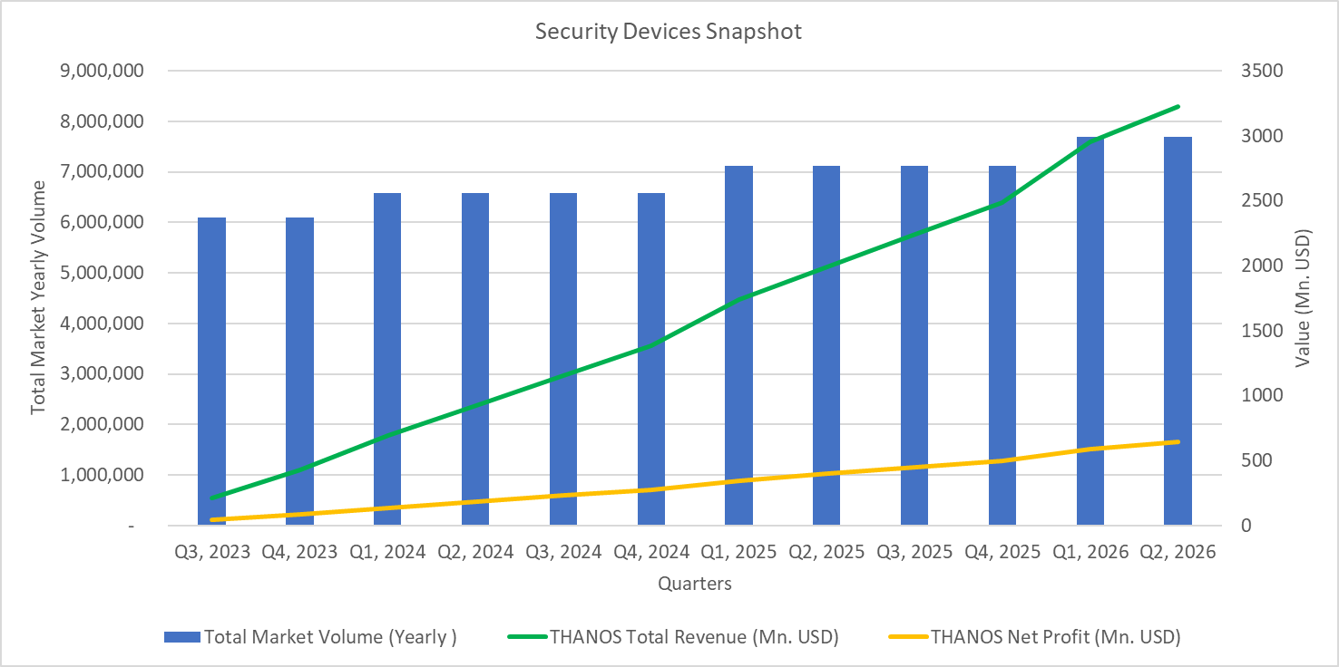
fat margin
3 Bn. USD 1st quarter revenue
43 Mn. USD 1st quarter net margin
T.H.A.N.O.S

Slide 51
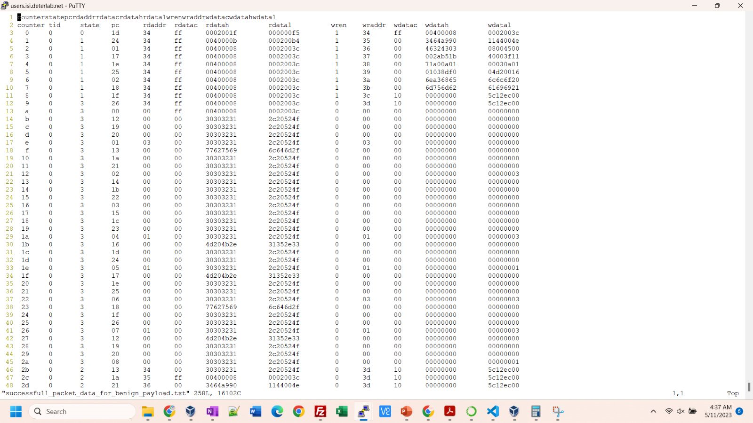
T.H.A.N.O.S

Slide 52
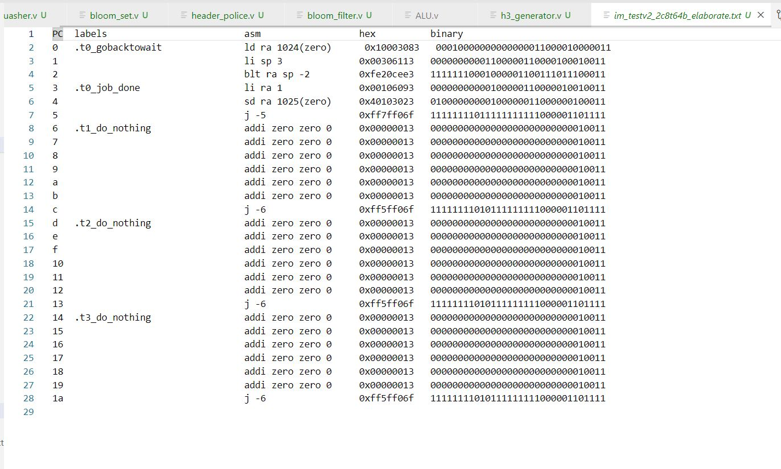
compiler elaborate format
Stable toolchain
T.H.A.N.O.S

Slide 53
T.H.A.N.O.S
5.5x
cost advantage
3x
price advantage
20%
net margin of leading players
24 Bn
Yearly Market Size
real solution
live demo

Slide 54
T.H.A.N.O.S
thank you professor and classmates
presenters
Yi-Chia(Paul) Chen
Tejas Bhardwaj
Harsh Kudtarkar
Jasneet Singh

Slide 55
Appendix

Slide 56
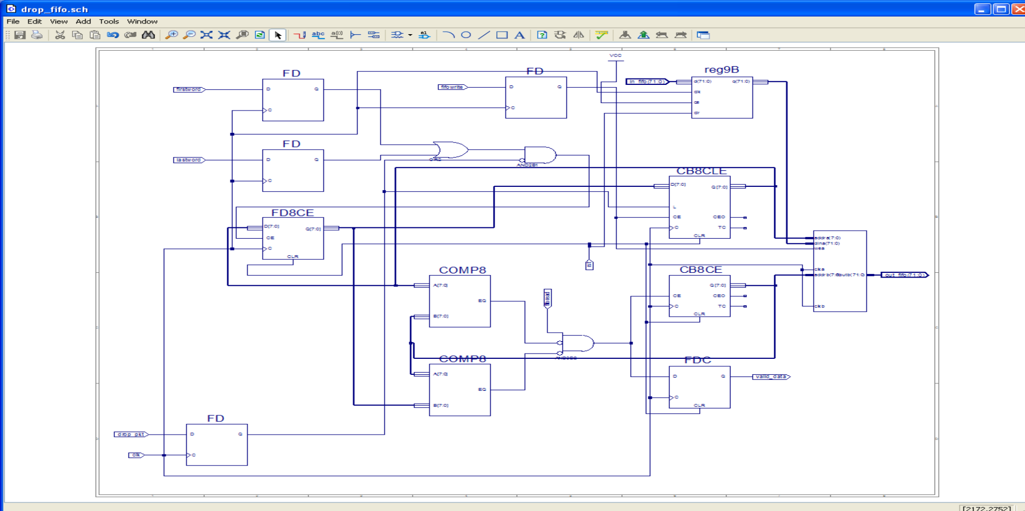
write pointer
write pointer history
256 deep x 72 bits
write pointer restoration logic when detect7B outputs 1 on DROP_PKT
compare current write pointer with read pointer
read pointer
compare previous write pointer with read pointer
drop fifo
Notes:
Purpose of this reg9B

Slide 57
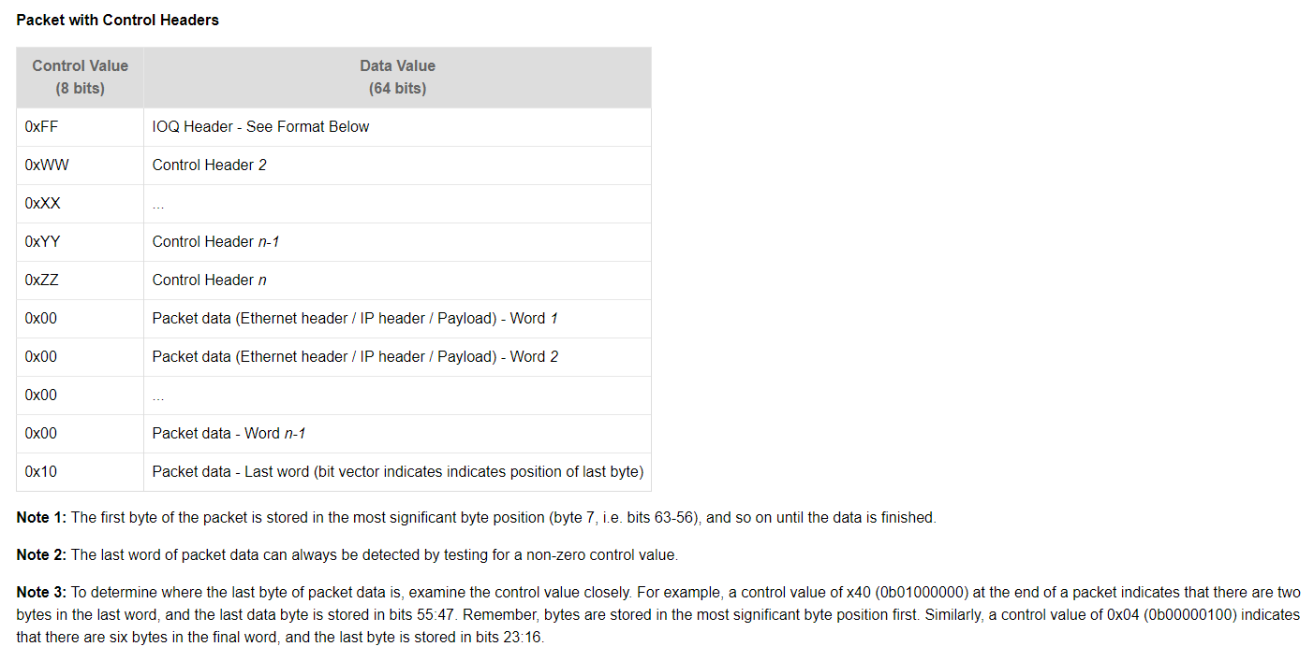
Packet structure
in theory
These headers are not part of the protocol but are internal headers used by NetFPGA architecture
Source: https://ecs-network.serv.pacific.edu/past-courses/2011-spring-ecpe-293b/tutorials/ethernet-hub-tutorial-implementation

Slide 58
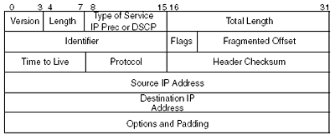
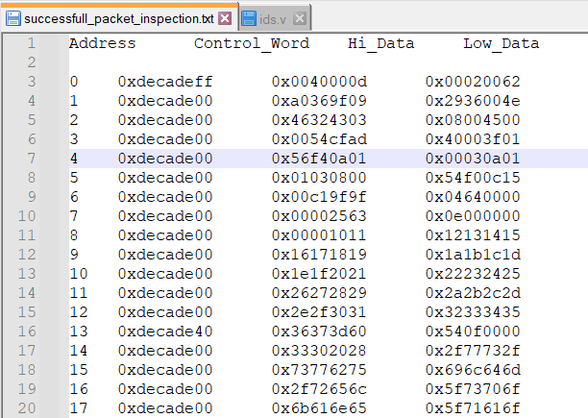
Packet structure
in practice
IPv4
32 bits
32 bits
IP header structure
Source IP address: 10.1.0.3
Destination IP address: 10.1.1.3
offset of 5 from readptr (in_ctrl == 0xFF) to access the lower 16 bits of IP address
Video hint: show the notepad++ captured file
File: successfull_packet_inspection.txt
This file uses the lab6 (mini-ids) bitfile to demonstrate the packet structure in NetFPGA

Slide 59
@reset
in_ctrl == 0
in_ctrl == 0
PAYLOAD State: Accepting data from Upstream and writing to FIFO
Start State: Wait for new packet
continue to read from fall through small fifo if fall through small fifo is not empty*
in_ctrl != 0
in_ctrl != 0
readptr == headptr
readptr != writeptr
job_complete != 0
READ_READY State: Reading from FIFO and sending to downstream
CPU State: Packet manipulation takes place here
job_complete == 1
*we continue to read from fall through small fifo else we would never get valid data, only after checking the contents of the data read from fall trhpugh small fifo, we can accept or reject the data (if in_fifo_ctrl_p !- 0xFF)

Slide 60
handshake of CPU with State Machine
State Machine
reads the current state from
ld t0 512(zero)
reads the current readptr from
ld t2 1024(zero)
writes the job completion status
sw sp 256(zero)
CPU
Video hint: show the lab10.s file in vscode and ids.v file in fedora

Slide 61

Reduced Block Diagram of 5-Stage Early Branch In-Order Single Issue Pipeline with HDU, IFRF
rs register for JALR
jalr
jal
PC at ID stage
0
1
0
HDU
1
IFID
IDEX
EXMEM
MEMWB
0
true branch
mem_read, mem_write, mem2reg, reg_write
mem2reg, reg_write
1
write_reg(4:0)
writereg(4:0)
reg_write
Control Unit
stall
alu_data(63:0)
mem2reg
0’s
funct7
memwrite
WBFF
0
stall
1
funct7
memread
1
bubble injection mux
rs1_
data
ALU
branch
Instruction memory
takes 1 clock cycle to fetch
32-bit wide 256 deep
0
alu_out
register file
1
64 bit
PC
8 bit wide
bralu
Data memory
64-bit wide,
256 deep
takes 1 clock to read data
0
1
funct3
1
rs2_
data
0
12 bit sign extender
0
1
0
Wrapper to include stall logic
sign_
extended
0’s
1
20 bit sign extender
load_w, store_w, immd_w, jal_w
load_w
store_w
funct3
0
funct3
jalr_w
0’s
1
writereg(4:0)

Slide 62
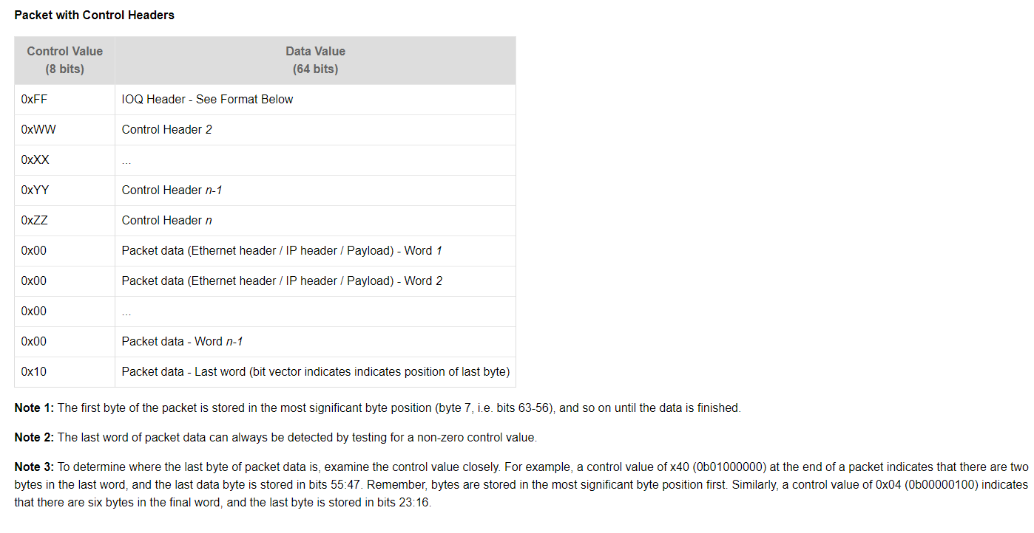
Analysis of packet inside NetFPGA
source: https://ecs-network.serv.pacific.edu/past-courses/2011-spring-ecpe-293b/tutorials/ethernet-hub-tutorial-implementation

Slide 63
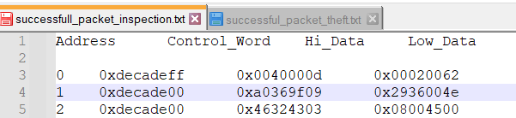
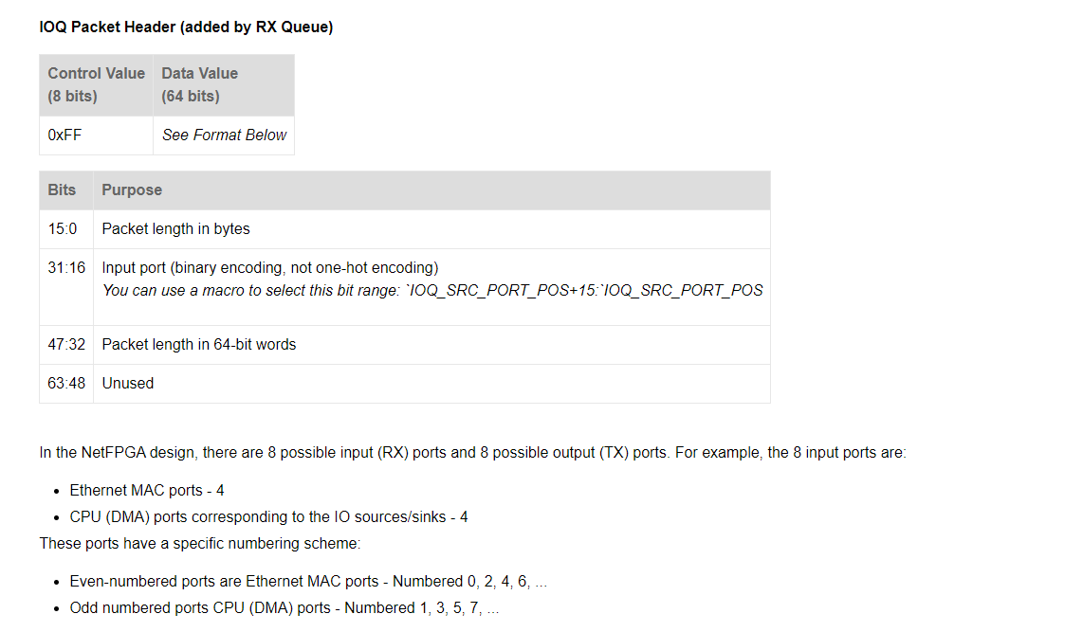
Analysis of packet inside NetFPGA – contd.
Value | Significance
0062 | 98 bytes
0002
000d | 13 64-bit words
0040
source: https://ecs-network.serv.pacific.edu/past-courses/2011-spring-ecpe-293b/tutorials/ethernet-hub-tutorial-implementation

Slide 64
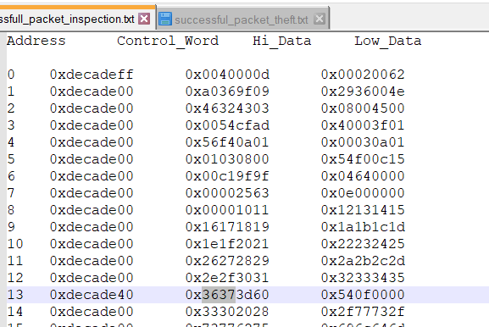
count begins from here
Byte Count | Cumulative byte count | 64-bit word count
8 | 8 | 1
8 | 16 | 2
8 | 24 | 3
8 | 32 | 4
8 | 40 | 5
8 | 48 | 6
8 | 56 | 7
8 | 64 | 8
8 | 72 | 9
8 | 80 | A
8 | 88 | B
8 | 96 | C
8 | 96 + 2 | d
40 means only 2 bytes are valid, its one-hot encoded

Slide 65
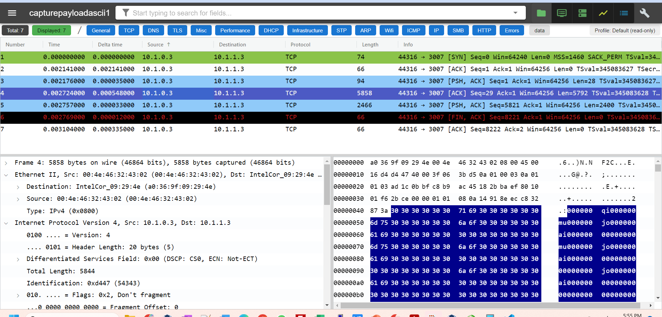

Slide 66
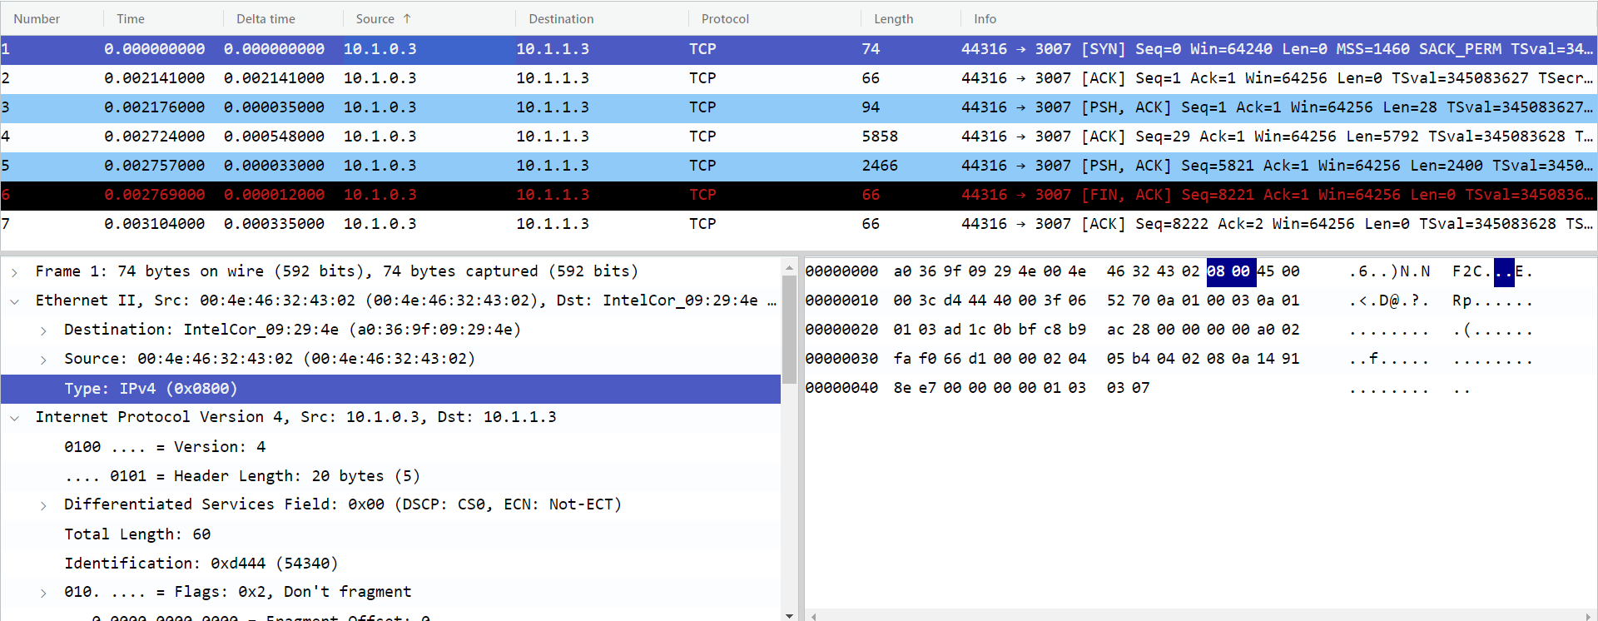
Field | Value
Destination MAC Address | a0:36:9f:09:29:4e
Source MAC address | 00:4e:46:32:43:02
Ethernet Type | Type: IPv4 (0x0800)

Slide 67
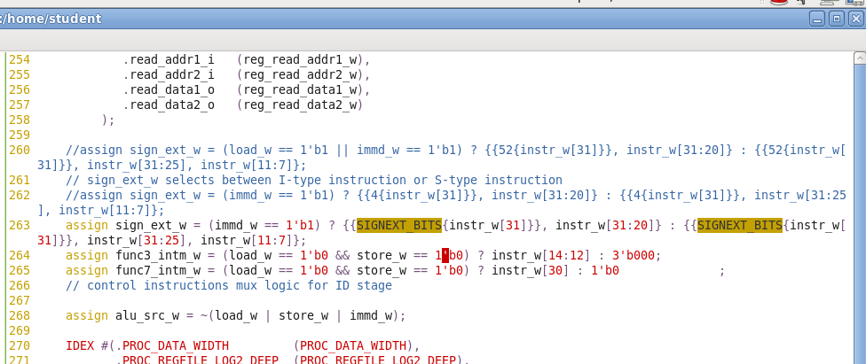
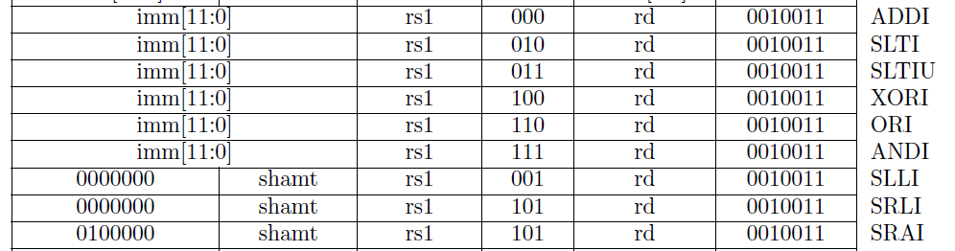
subtle bug immediate arithmetic instructions other than shift-type
suppose instruction is
addi fp fp -1
binary is
1111_1111_1111_0100_0000_0100_0001_0011
control unit would output immd_w = 1, load_w=0 and store_w=0
sign_ext_w shall be rightfully
assigned {52{1’b1} 12{1’b1}}
funct3_w shall rightfully receive 3’b000 (corresponding to addition)
but funct7_w shall receive instr_w[30] = 1’b1 (corresponding to subtraction) whereas we were trying to do addition
This problem shall manisfest for all immediate arithmetic instructions that accept 12 bit offset
We are lucky because till now li that is translated to ori didn’t have to load a large value whose 30th bit could be 1

Slide 68
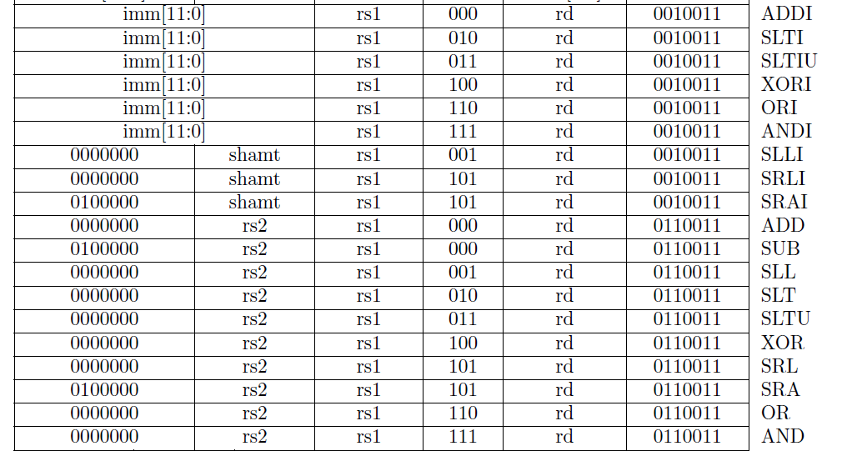
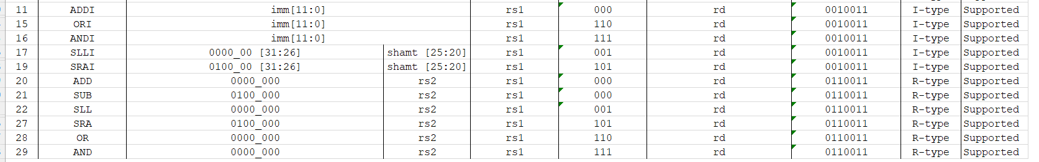
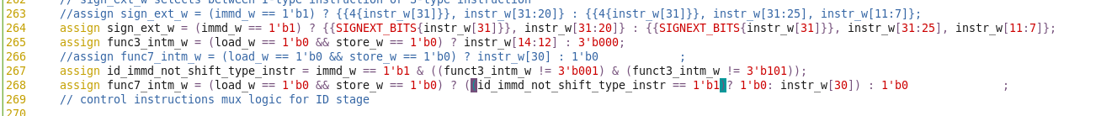
subtle bug addi ra, ra, -1 solution

Slide 69
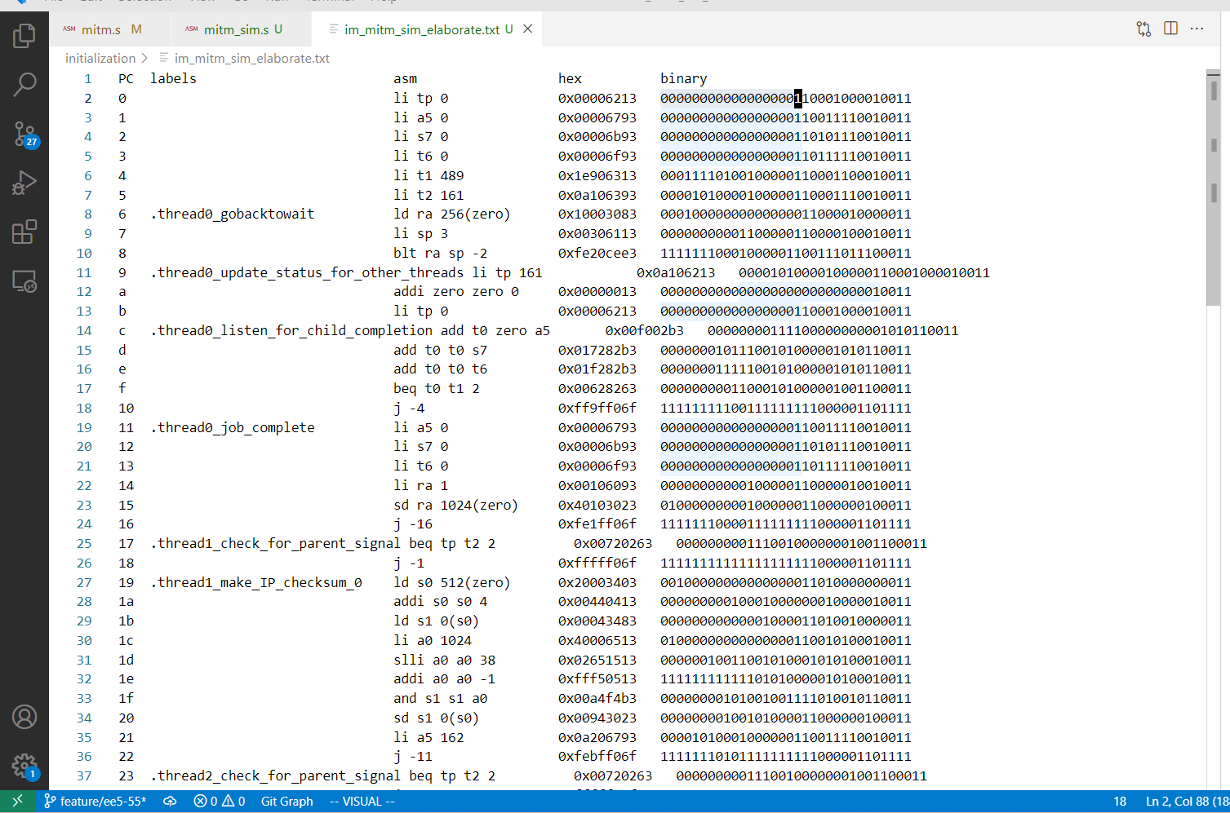
subtle bug in inter-thread communication

Slide 70
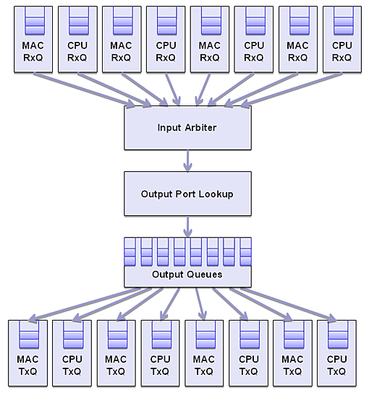
Linus OS + Software Interface
Custom Design

Slide 71
from Output Port Lookup
in_ctrl
in_data
dual core & accelerator
in_wr
in_rdy
ARBITER Front-End
Core0
Core1
Thread0
Thread0
PAYLOAD
PAYLOAD
Thread1
Thread1
CPU
START
START
CPU
Thread2
Thread2
READ
READ
Thread3
Thread3
ARBITER Back-End
out_ctrl
out_rdy
out_data
out_wr
to Output Queue

Slide 72
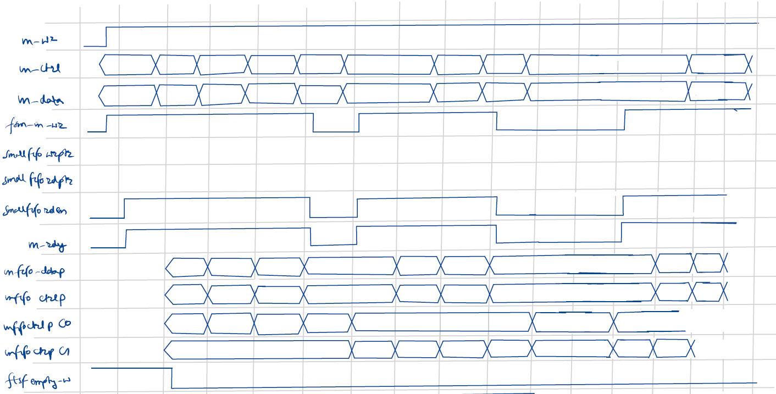
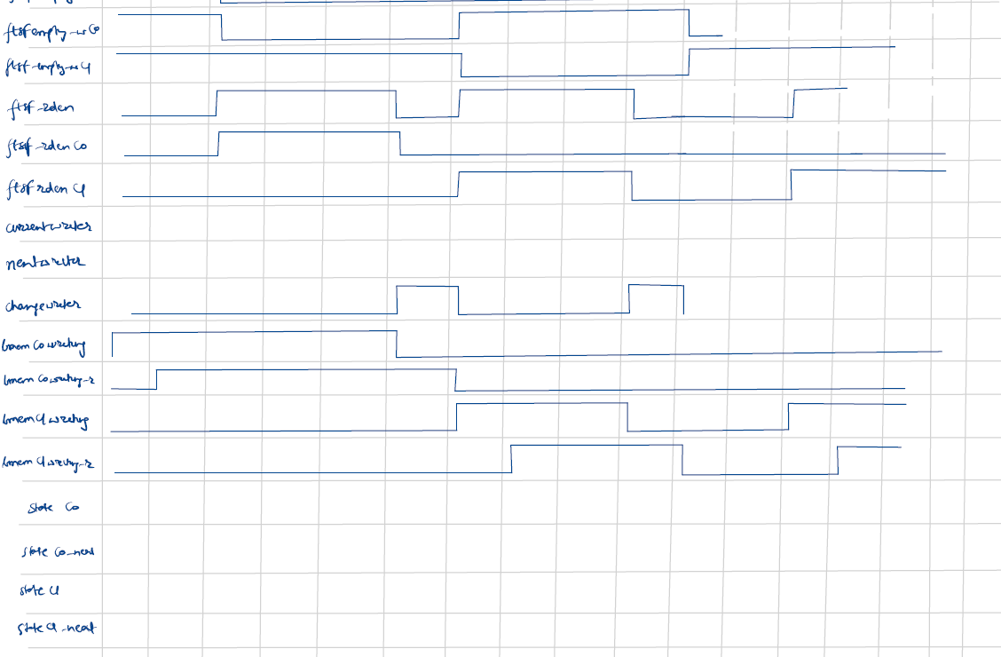
in_wr
in_ctrl
0xFF
0x00
0x40
0xFF
0x00
0x40
0xFF
0x00
0x40
0xFF
in_data
0x01
0x02
0x03
0x04
0x05
0x06
0x07
0x08
0x09
0x0a
fsm_in_wr
1
smallfifo_wrptr
0
1
2
3
0
1
1
2
3
0
0
0
0
smallfifo_rdptr
0
0
1
2
3
0
0
1
2
3
3
3
3
0
smallfifo_rden
in_rdy
0x08
smart writer logic
in_fifo_data_p
0x01
0x02
0x03
0x04
0x05
0x06
0x07
in_fifo_ctrl_p
0xFF
0x00
0x40
0xFF
0x00
0x40
0xFF
0x00
in_fifo_ctrl_pC0
0xFF
0x00
0x40
0xFF
0x00
0xFF
0x00
in_fifo_ctrl_pC1
0x00
0xFF
0x00
0x40
0xFF
0x00
0xFF
0x00
ftsf_empty_w
ftsf_empty_wC0
ftsf_empty_wC1
ftsf_rd_en
ftsf_rd_enC0
ftsf_rd_enC1
current_writer
C0
C0
C0
C0
C0
C0
C1
C1
C1
C1
C0
C0
C1
next_writer
C0
C0
C0
C0
C0
C1
C1
C1
C1
C0
C0
C1
C1
change_writer
bmemC0_writing
bmemC0_writing_r
bmemC1_writing
bmemC1_writing_r
stateC0
0
0
0
1
1
3
3
3
3
3
3
3
3
3
2
0
stateC0_next
0
0
1
1
3
3
3
3
3
3
3
3
3
2
0
stateC1
0
0
0
0
0
0
0
1
1
3
2
0
0
1
stateC1_next
0
0
0
0
0
0
1
1
3
2
0
0
1

Slide 73
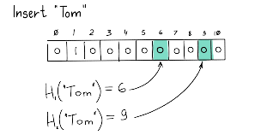
Accelerator
Core0
cpu0_req
{
Thread0
headers + payload
Packet Deconstruction Bank
C = 10
Thread1
IP Header
λ
busy
Source IP
h3 hash f^{n} - 0
λ
λ
client_id
Destination IP
λ
Thread2
valid
match
protocol
Thread3
({ip_headers, tcp_headers, 7_bytes_of_payload})
λ
TCP Header
λ
({ip_headers, tcp_headers, 7_bytes_of_payload})
h3 hash f^{n} - 1
λ
λ
busy
Source Port
({ip_headers, tcp_headers, 7_bytes_of_payload})
client_id
Destination Port
valid
λ
Core1
match
Payload
λ
h3 hash f^{n} - 2
λ
Thread0
1st 7 bytes
λ
2nd 7 bytes
({ip_headers, tcp_headers, 7_bytes_of_payload})
Thread1
busy
3rd 7 bytes
client_id
({ip_headers, tcp_headers, 7_bytes_of_payload})
Thread2
valid
λ
match
λ
cpu1_req
h3 hash f^{n} – n^{th}
λ
λ
Thread3
headers + payload
10th 7 bytes
Image Credits
Bloom Filter - Building a Bloom filter - Blog | luminousmen
Concatenation - https://stackoverflow.com/questions/54613400/how-does-one-describe-signal-concatenation-with-logic-diagram-blocks

